Slide 1
Installing Visual Studio Code and using Jupyter Notebooks
A guide for Windows, Mac and Linux
Notes:
Slide 1: What is Visual Studio Code? "Visual Studio Code, or VS Code, is a free, lightweight code editor. It supports multiple programming languages, offers extensions for added functionality, and is great for writing, debugging, and running code efficiently."
Slide 2: What’s the Point of VS Code? "The point of VS Code is to provide developers with a fast, customizable, and user-friendly platform to write and manage code. Its extensions, like Python or Git, make it powerful for a wide range of tasks."
Slide 3: What is a Jupyter Notebook? "A Jupyter Notebook is an interactive tool for data analysis and visualization. It lets you write code, display results, and include explanatory text all in one document, making it perfect for data science and machine learning projects."
Would you like me to expand on any section?

Slide 2
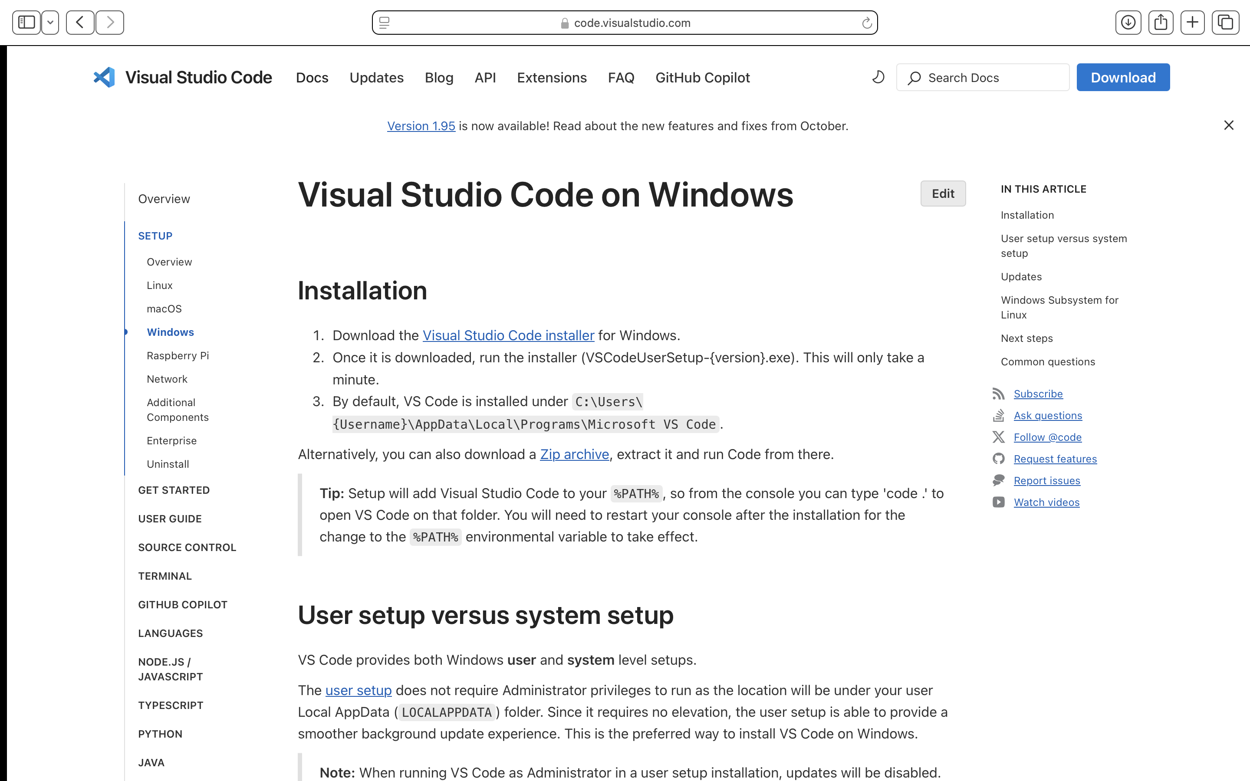
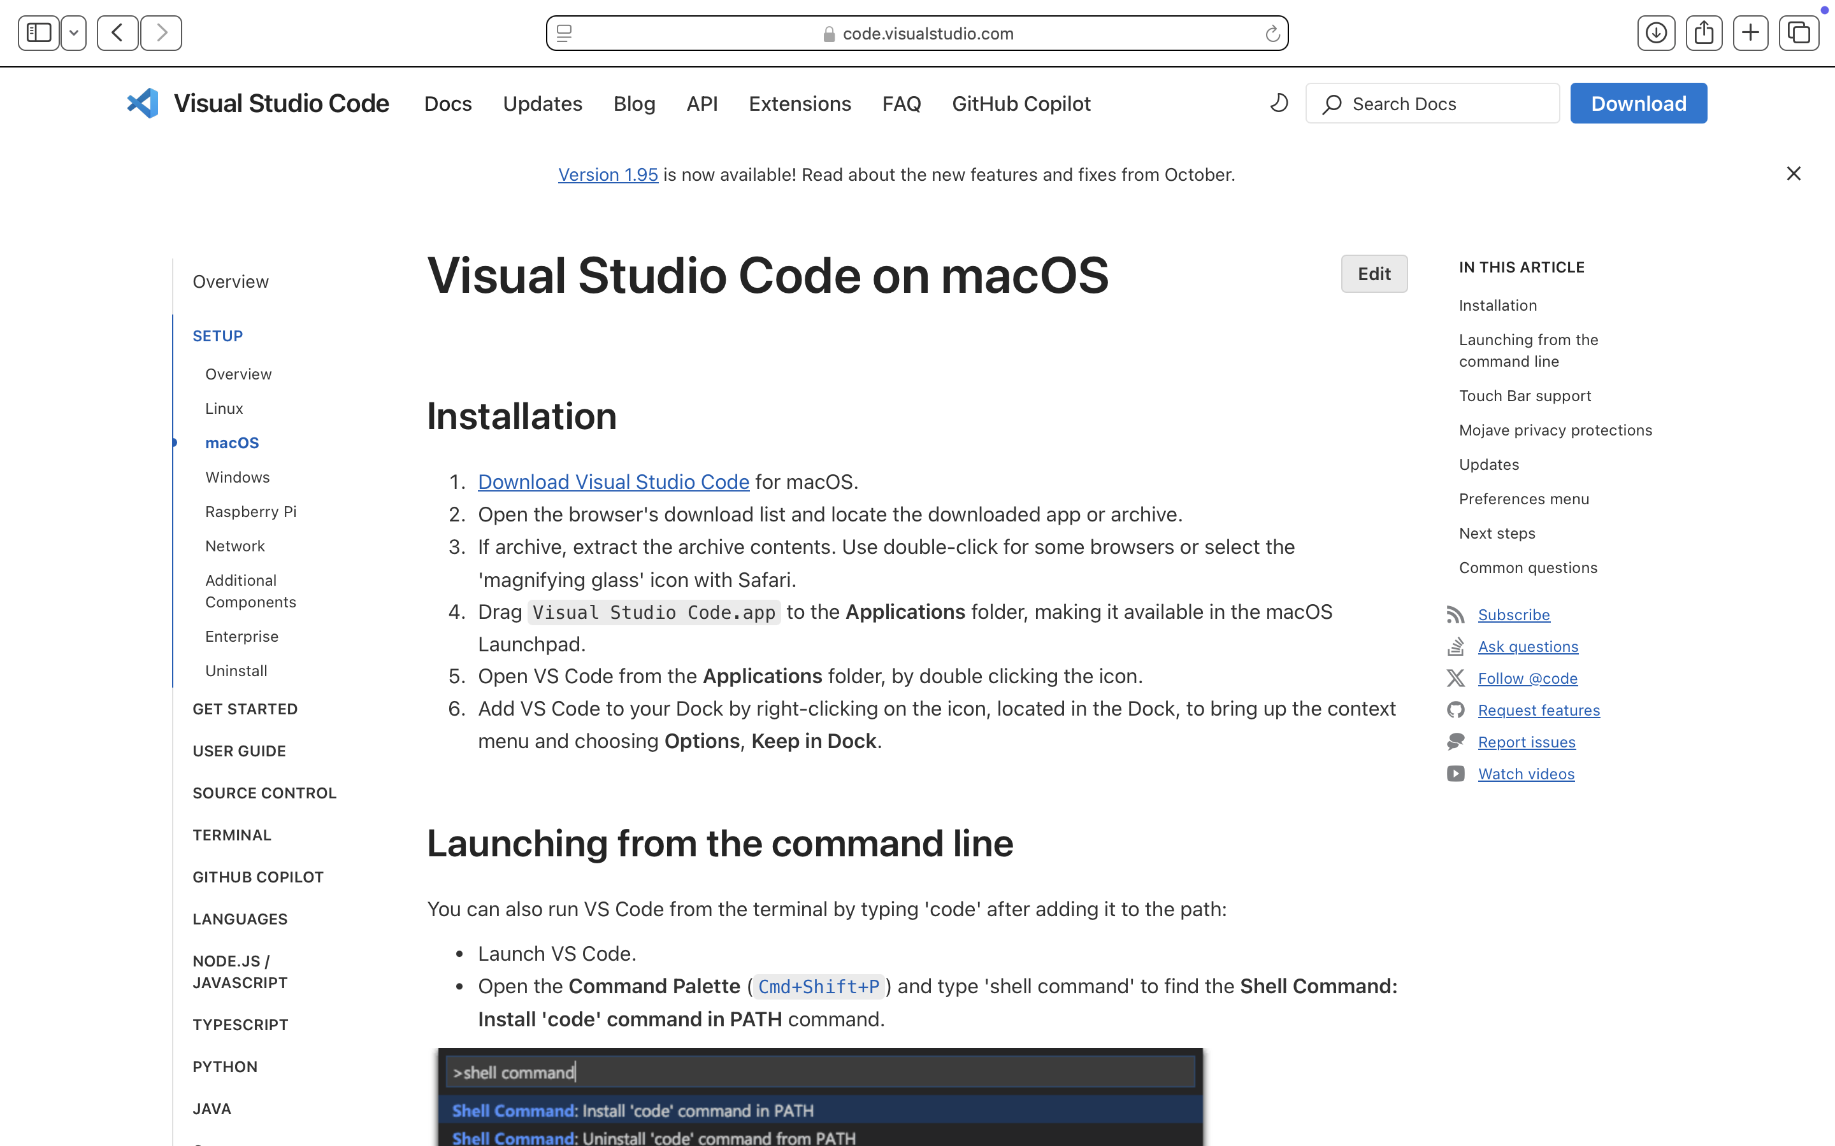
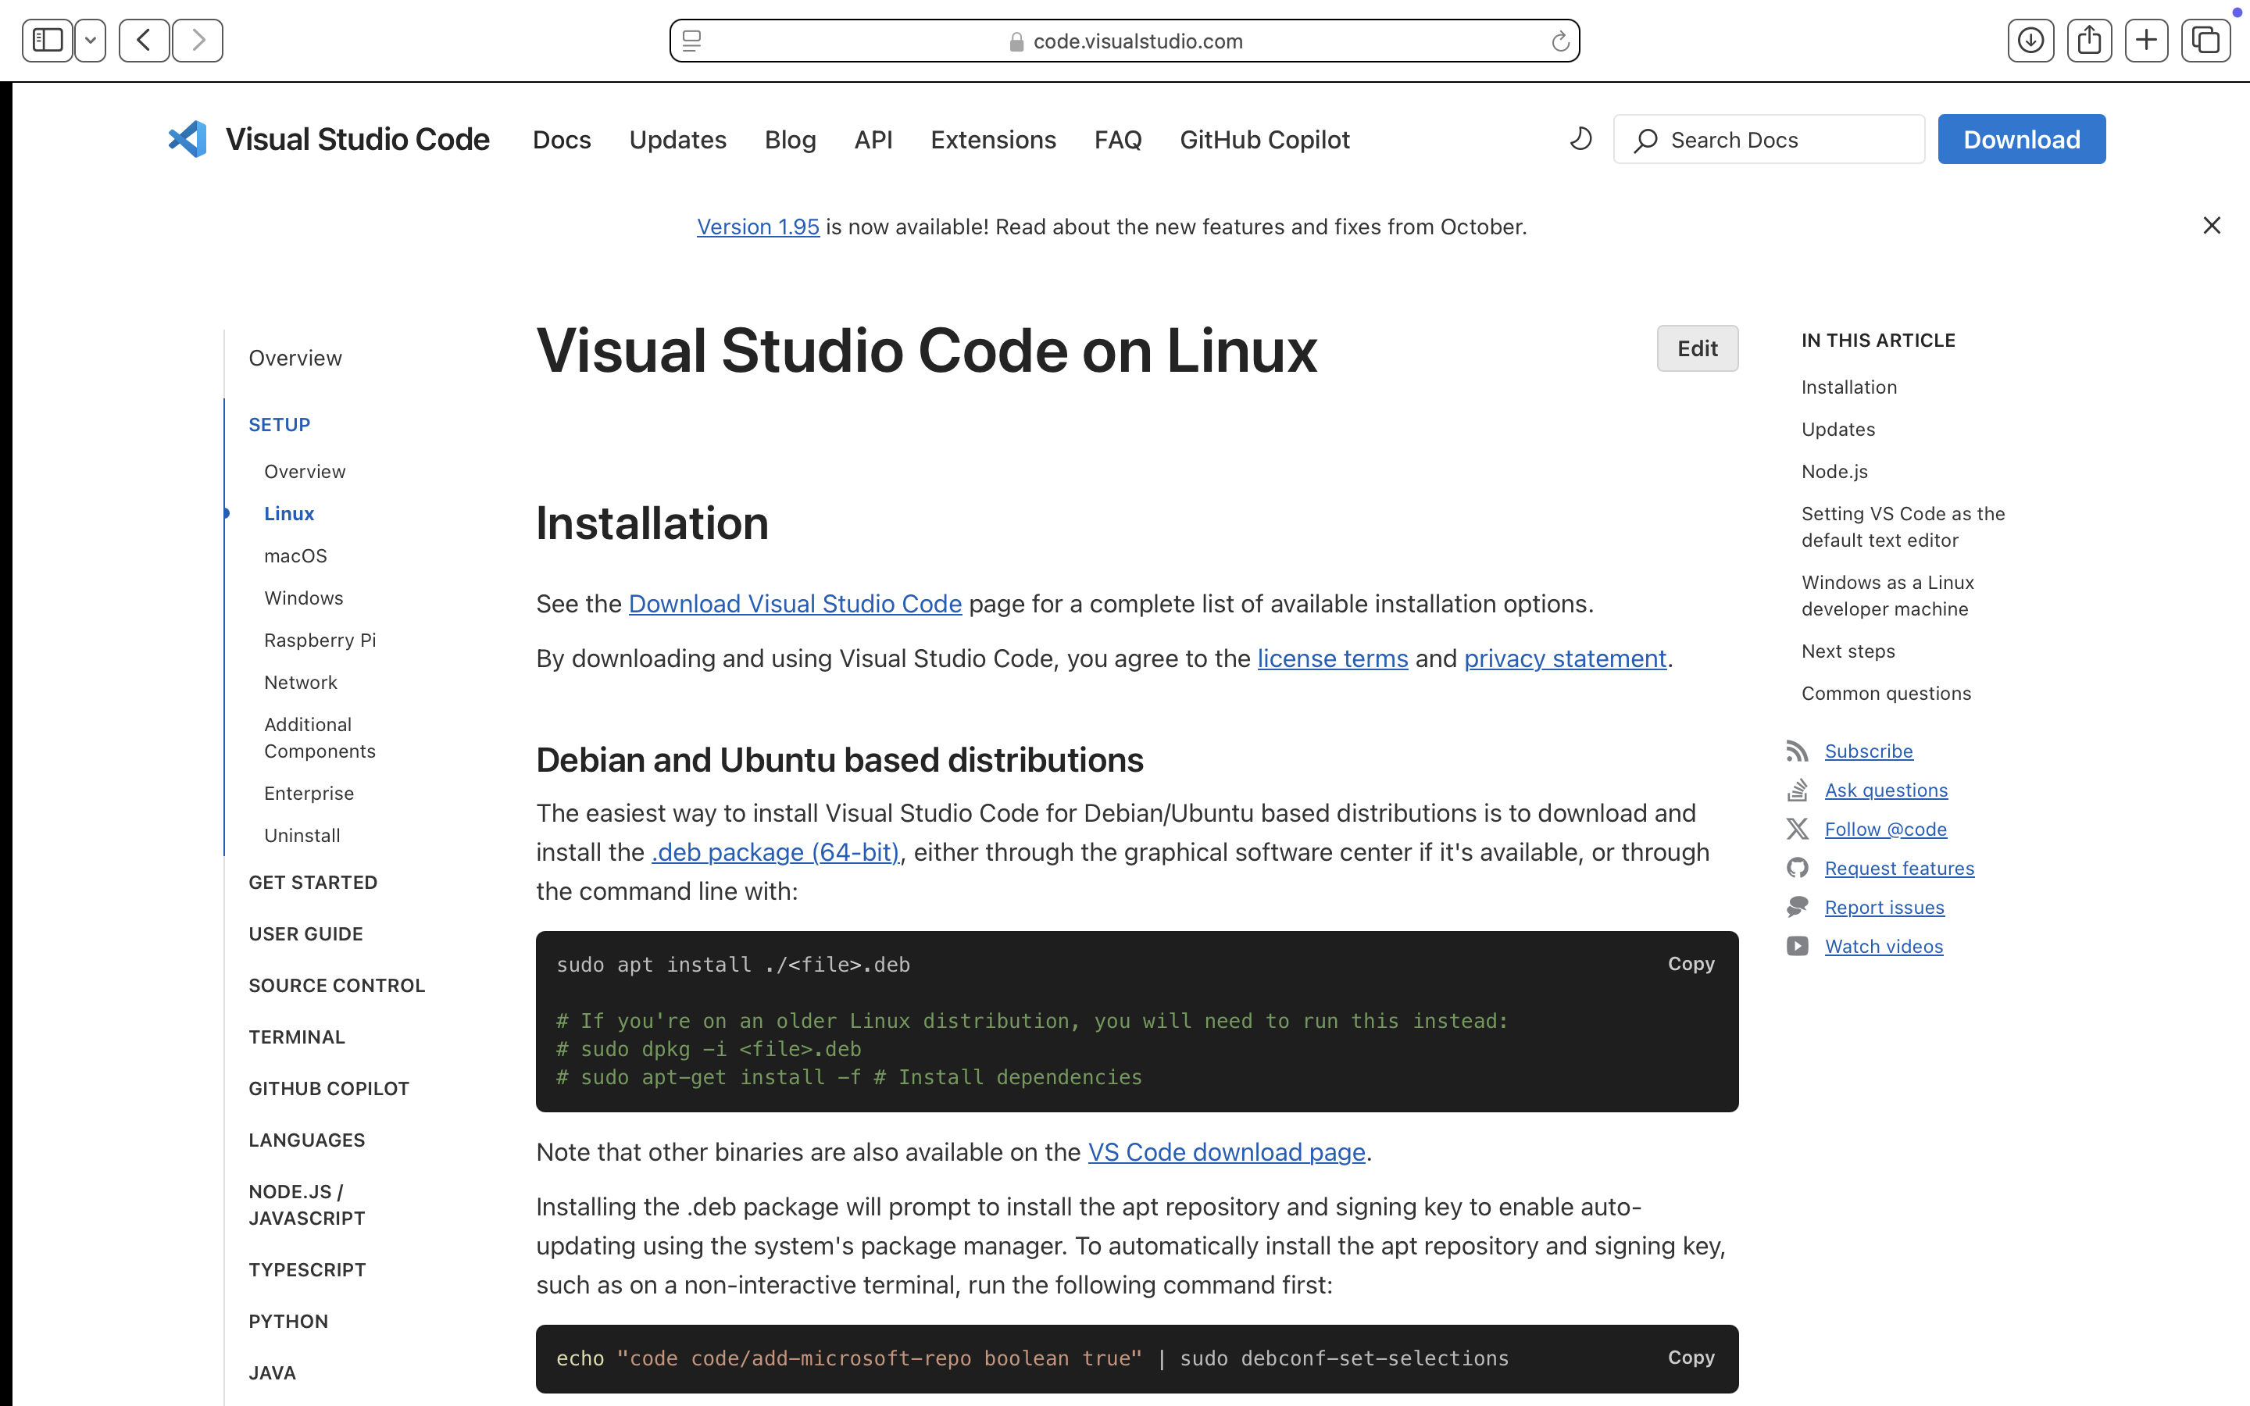
Installation Guides
MacOS – https://code.visualstudio.com/docs/setup/mac
Windows – https://code.visualstudio.com/docs/setup/windows
Linux – https://code.visualstudio.com/docs/setup/linux

Slide 3
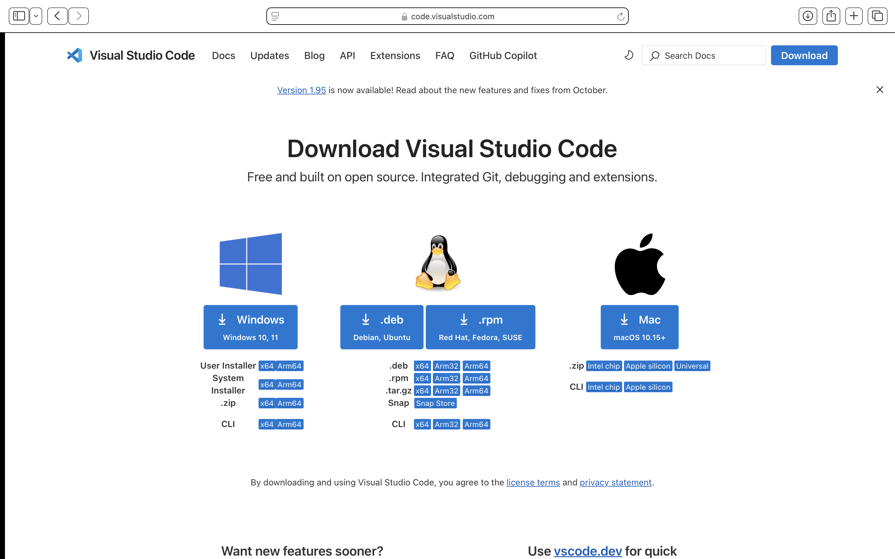
Download Visual Studio Code
https://code.visualstudio.com/download

Slide 4
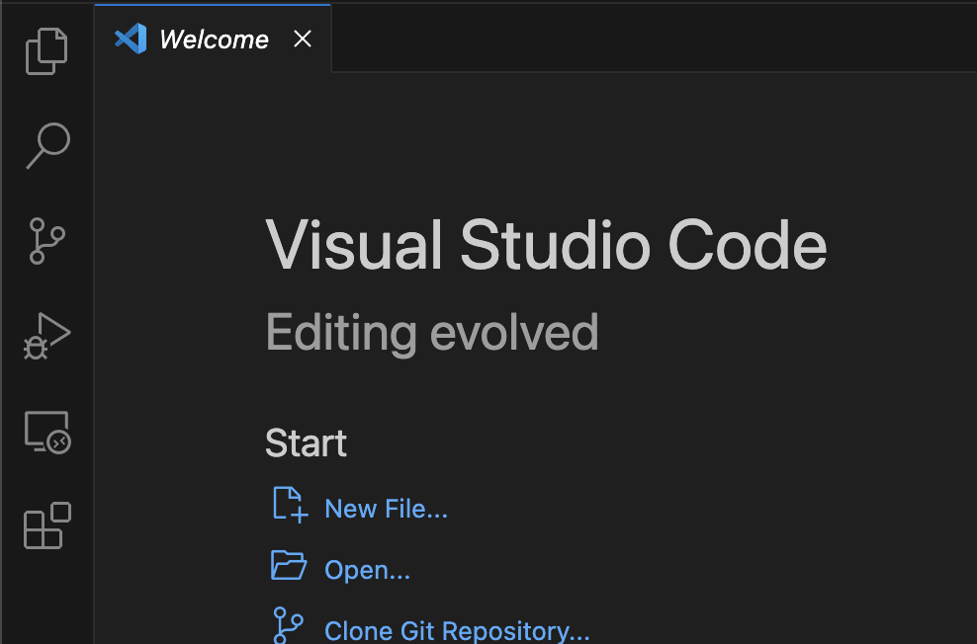
VS Code - Extensions
Extensions are needed in VS Code to enable Python and Jupyter Notebooks usage.
The following extensions will need to be installed via the marketplace on VS Code.
Python
Jupyter
Through installation of these two extensions, additional extensions will be installed (eg. Jupyter Notebook Renderers, Jupyter Cell Tags and Jupyter Keymap)
extensions
Select install
Search here for Python and Jupyter

Slide 5
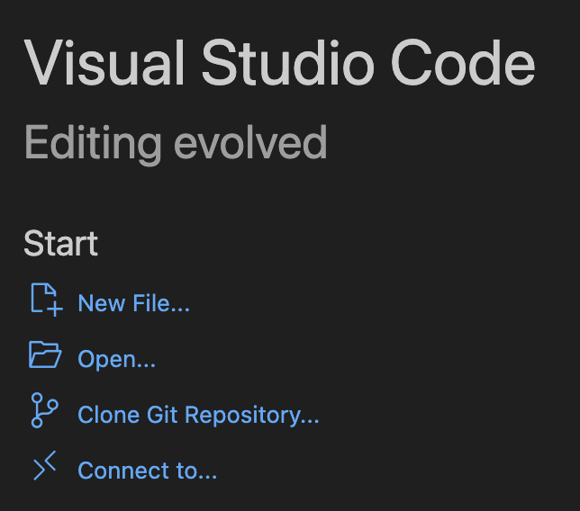
Starting a new Jupyter notebook
Step 2
Open VS Code
Select new file
Select Jupyter Notebook from the drop-down menu
File -> Save As… -> choose folder and rename file {new_name}.ipynb
Click ‘Select Kernel’
Select ‘Python Environment’ from drop-down menu
Select conda environment of choice
Step 3
Step 4
Step 5

Slide 6
Working with Jupyter Notebook
Run the entire notebook
(Run command for the one selected cell: shift enter)
Current active environment
Indicates whether cell is code (Python) or text (markdown)
Add new cell (either code or markdown)

Slide 7
Open a new Jupyter notebook (.ipynb file) and save it to your folder of choice. Title it ‘challenge_yourself’ and connect it to your conda environment made in the previous video.
For the future challenge yourself components of the slides, save your work to this file.
Challenge Yourself

